Slide 1
Draft plots for myography trade-off work

Slide 2
Transient contractions (C4P)
I apologize that the genotype colors are inconsistent across plots, I realized this as I was putting it together and I don’t have time to fix it tonight but I will get it fixed by whenever we next meet

Slide 3
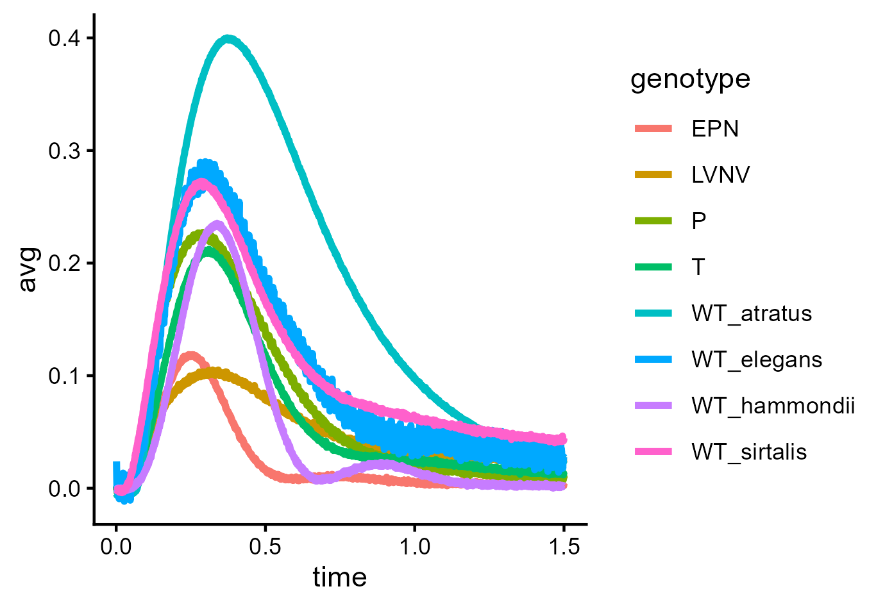
All

Slide 4
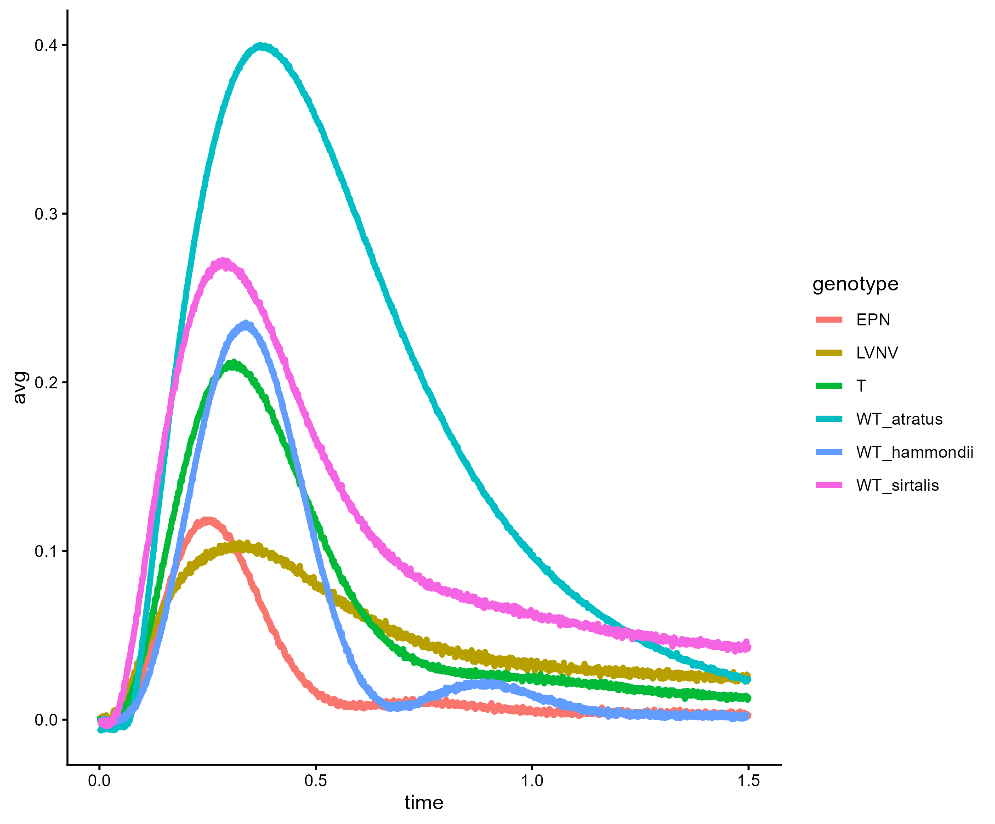
Prev minus WT elegans and P
Notes:
Traces showing most of the genotypes, I went ahead and left off the elegans wild type and the P allele from atratus because I didn’t see us including either of those.

Slide 5
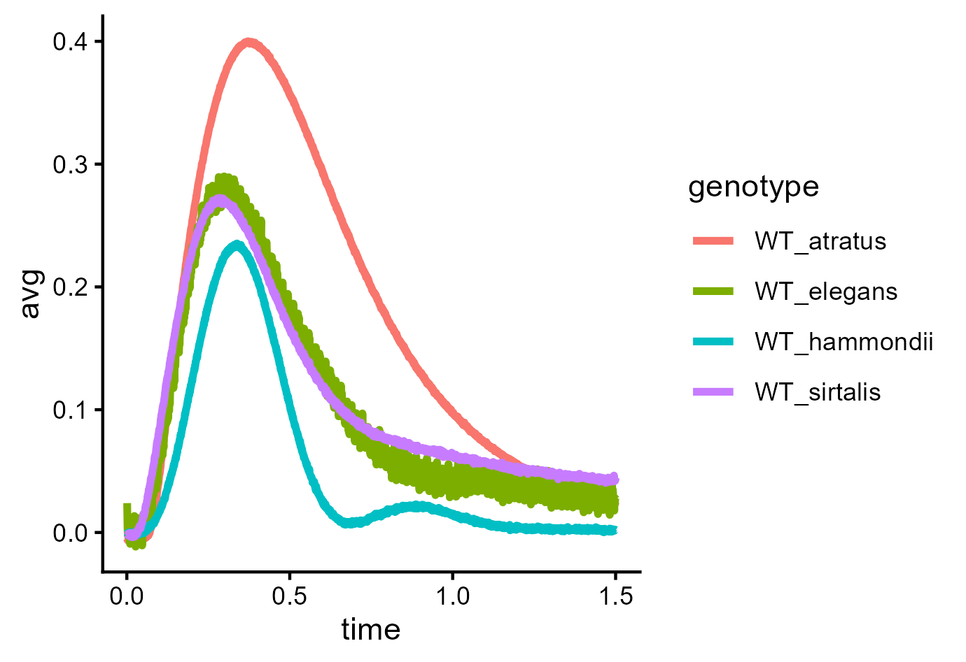
All WT

Slide 6
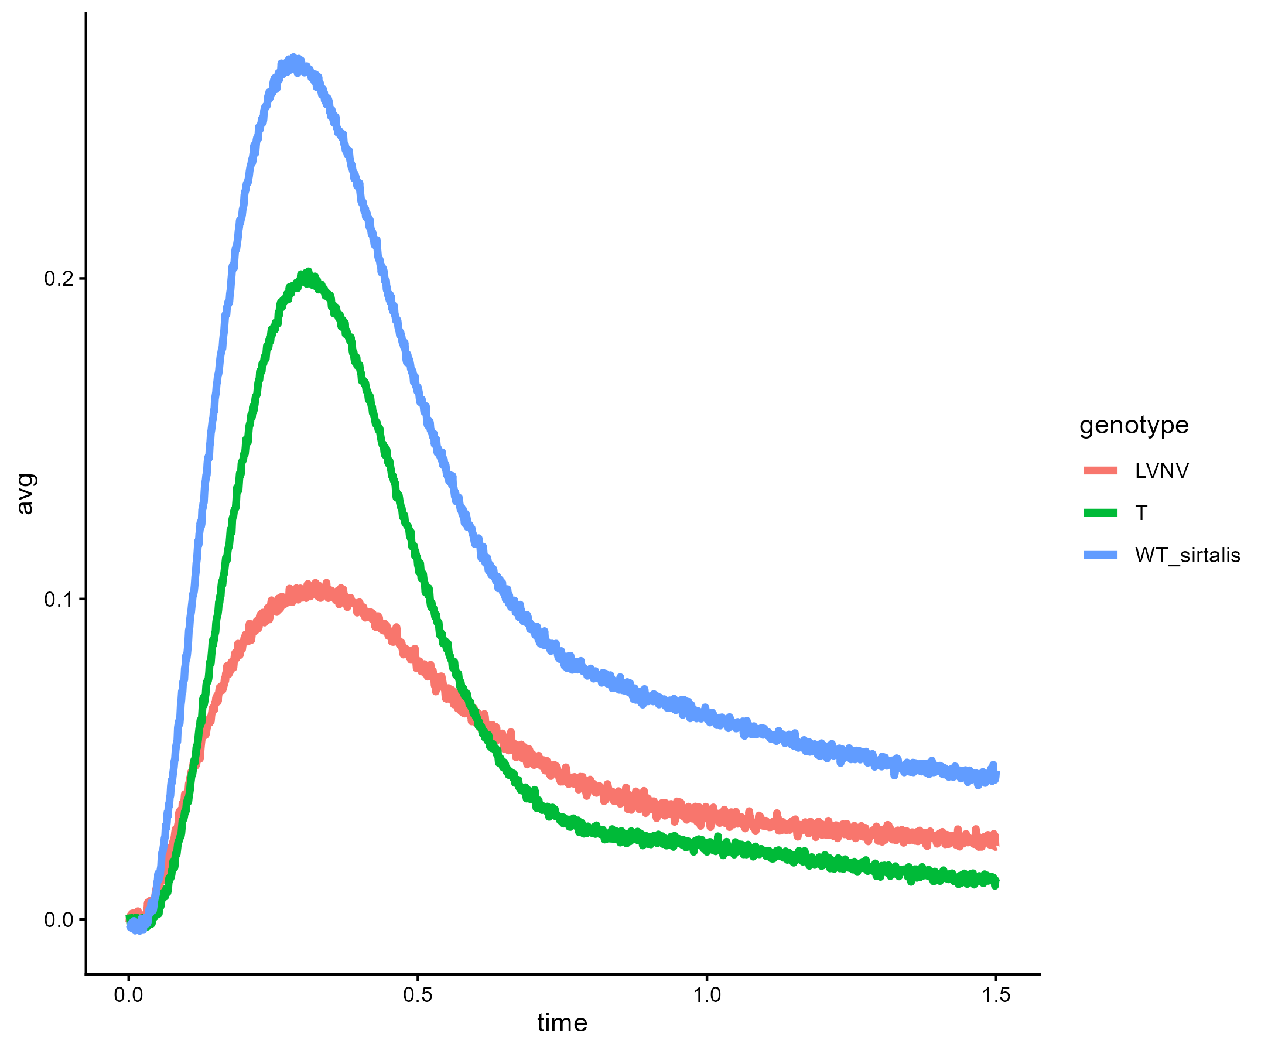
LVNV, T, WT sirtalis
Notes:
Subset of previous plot with just LVNV, WT sirtalis, and T (couchii)

Slide 7
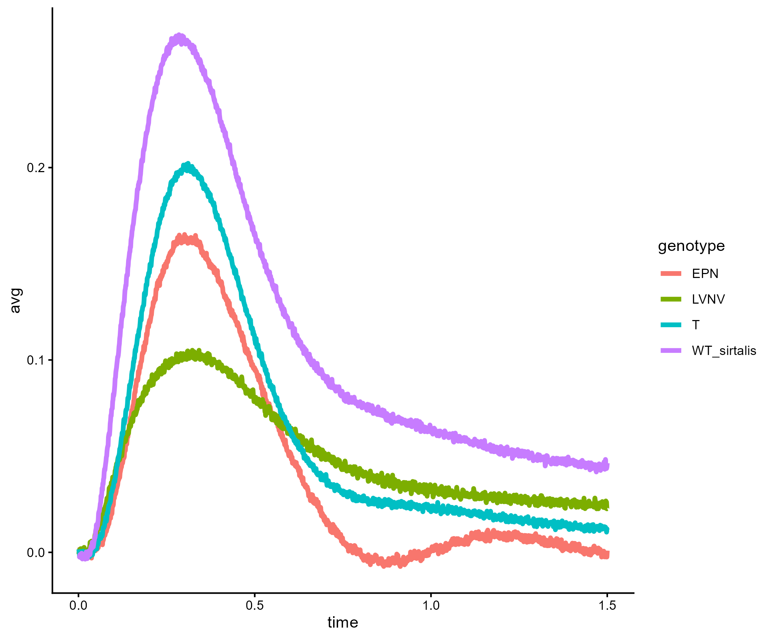
EPN, LVNV, T, WT sirtalis
Notes:
Subset of previous plot with just LVNV, WT sirtalis, EPN, and T (couchii)

Slide 8
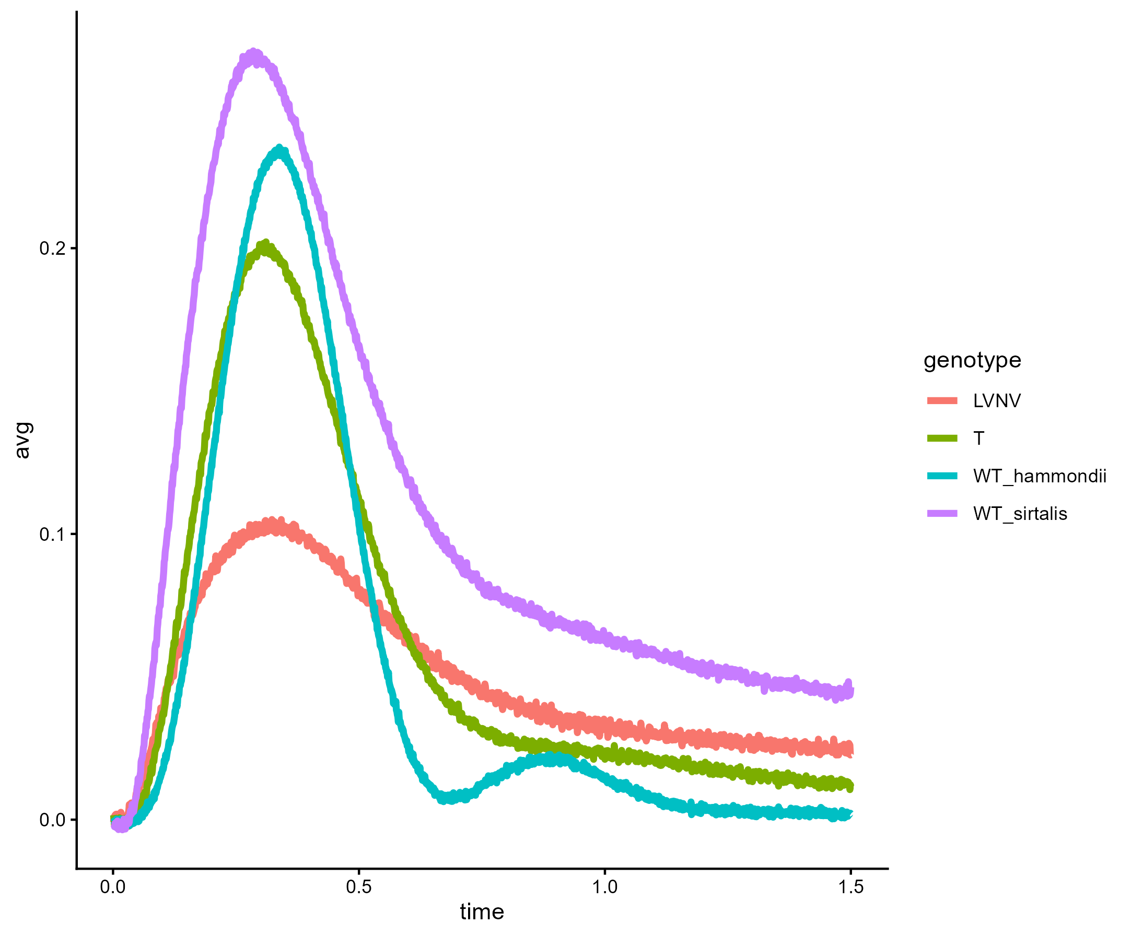
T, LVNV, WT sirtalis, hammondii
Notes:
Subset of previous plot with just LVNV, WT sirtalis, WT hammondii, and T (couchii)

Slide 9
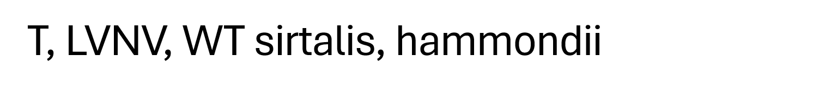
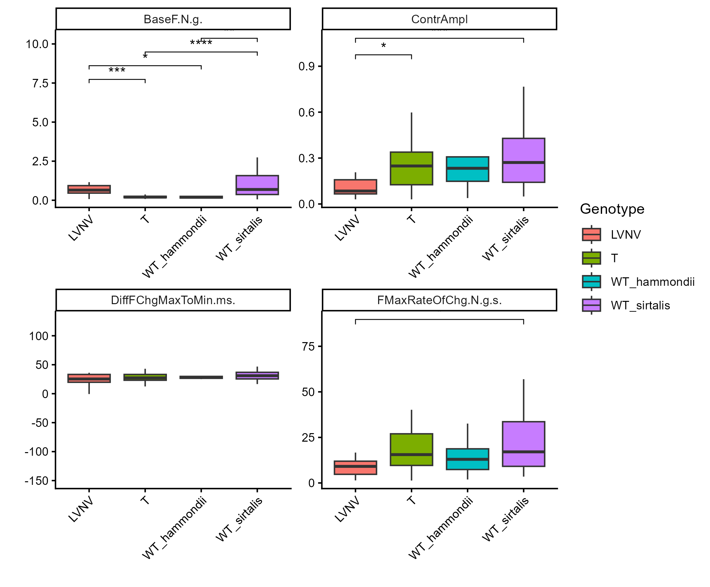
Notes:
Boxplots comparing summary statistics for the transient contraction performance curves for these 4 genotypes/species. Bars with asterisks indicate significant differences, number of asterisks indicates higher significance. Differences in significance between mine and bobby’s results are probably because of some pseudoreplication I think he did in his stats, I can explain tomorrow. In order, plots are Base force, Contraction amplitude, time from fastest increase to fastest decrease in force (one measurement of contraction speed), and the maximum rate of force generation during the contraction.

Slide 10
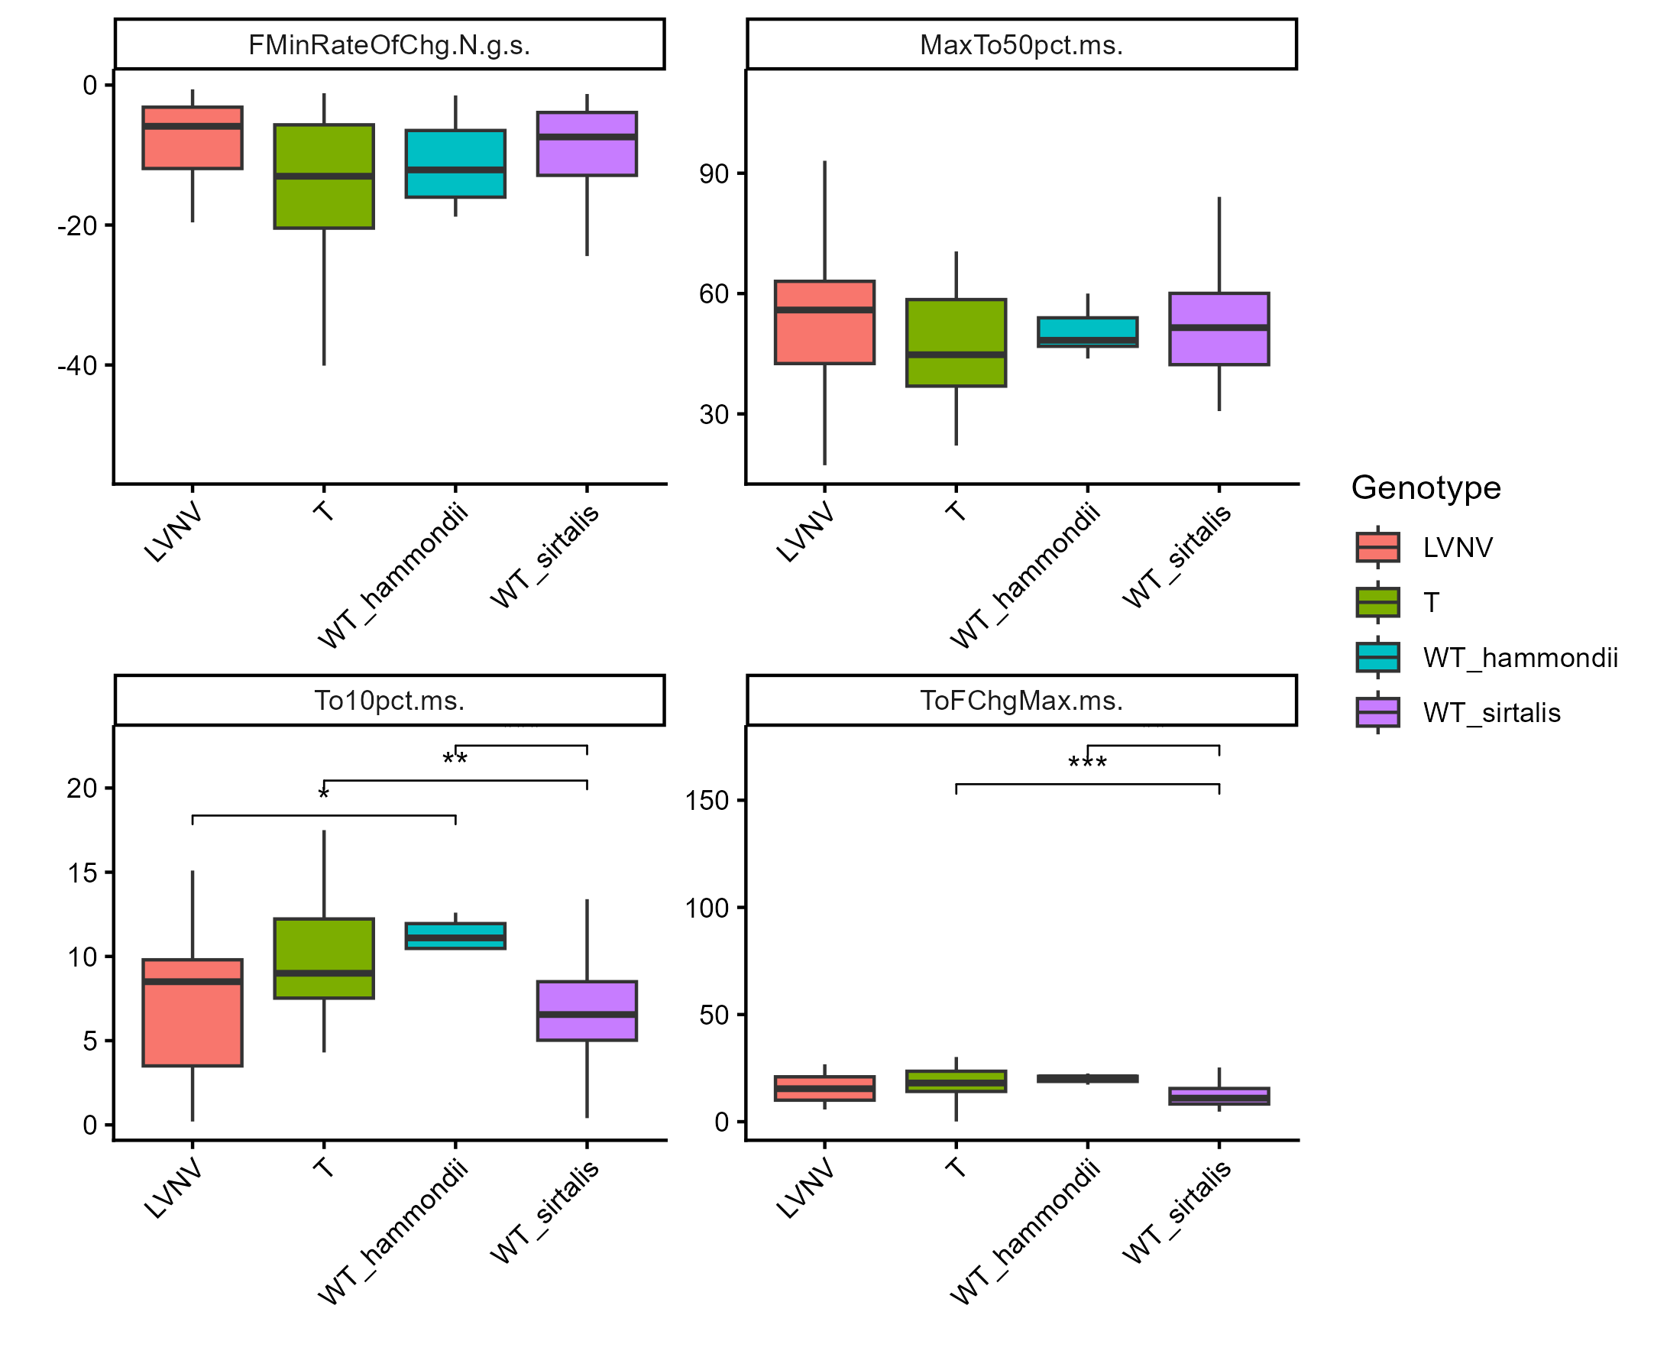
Notes:
Prev plots continued. In order, they are the minimum rate of force generation (aka fastest relaxation), time from max contraction to 50% relaxed, time to 10X contraction (onset), and time to maximum rate of force generation.

Slide 11
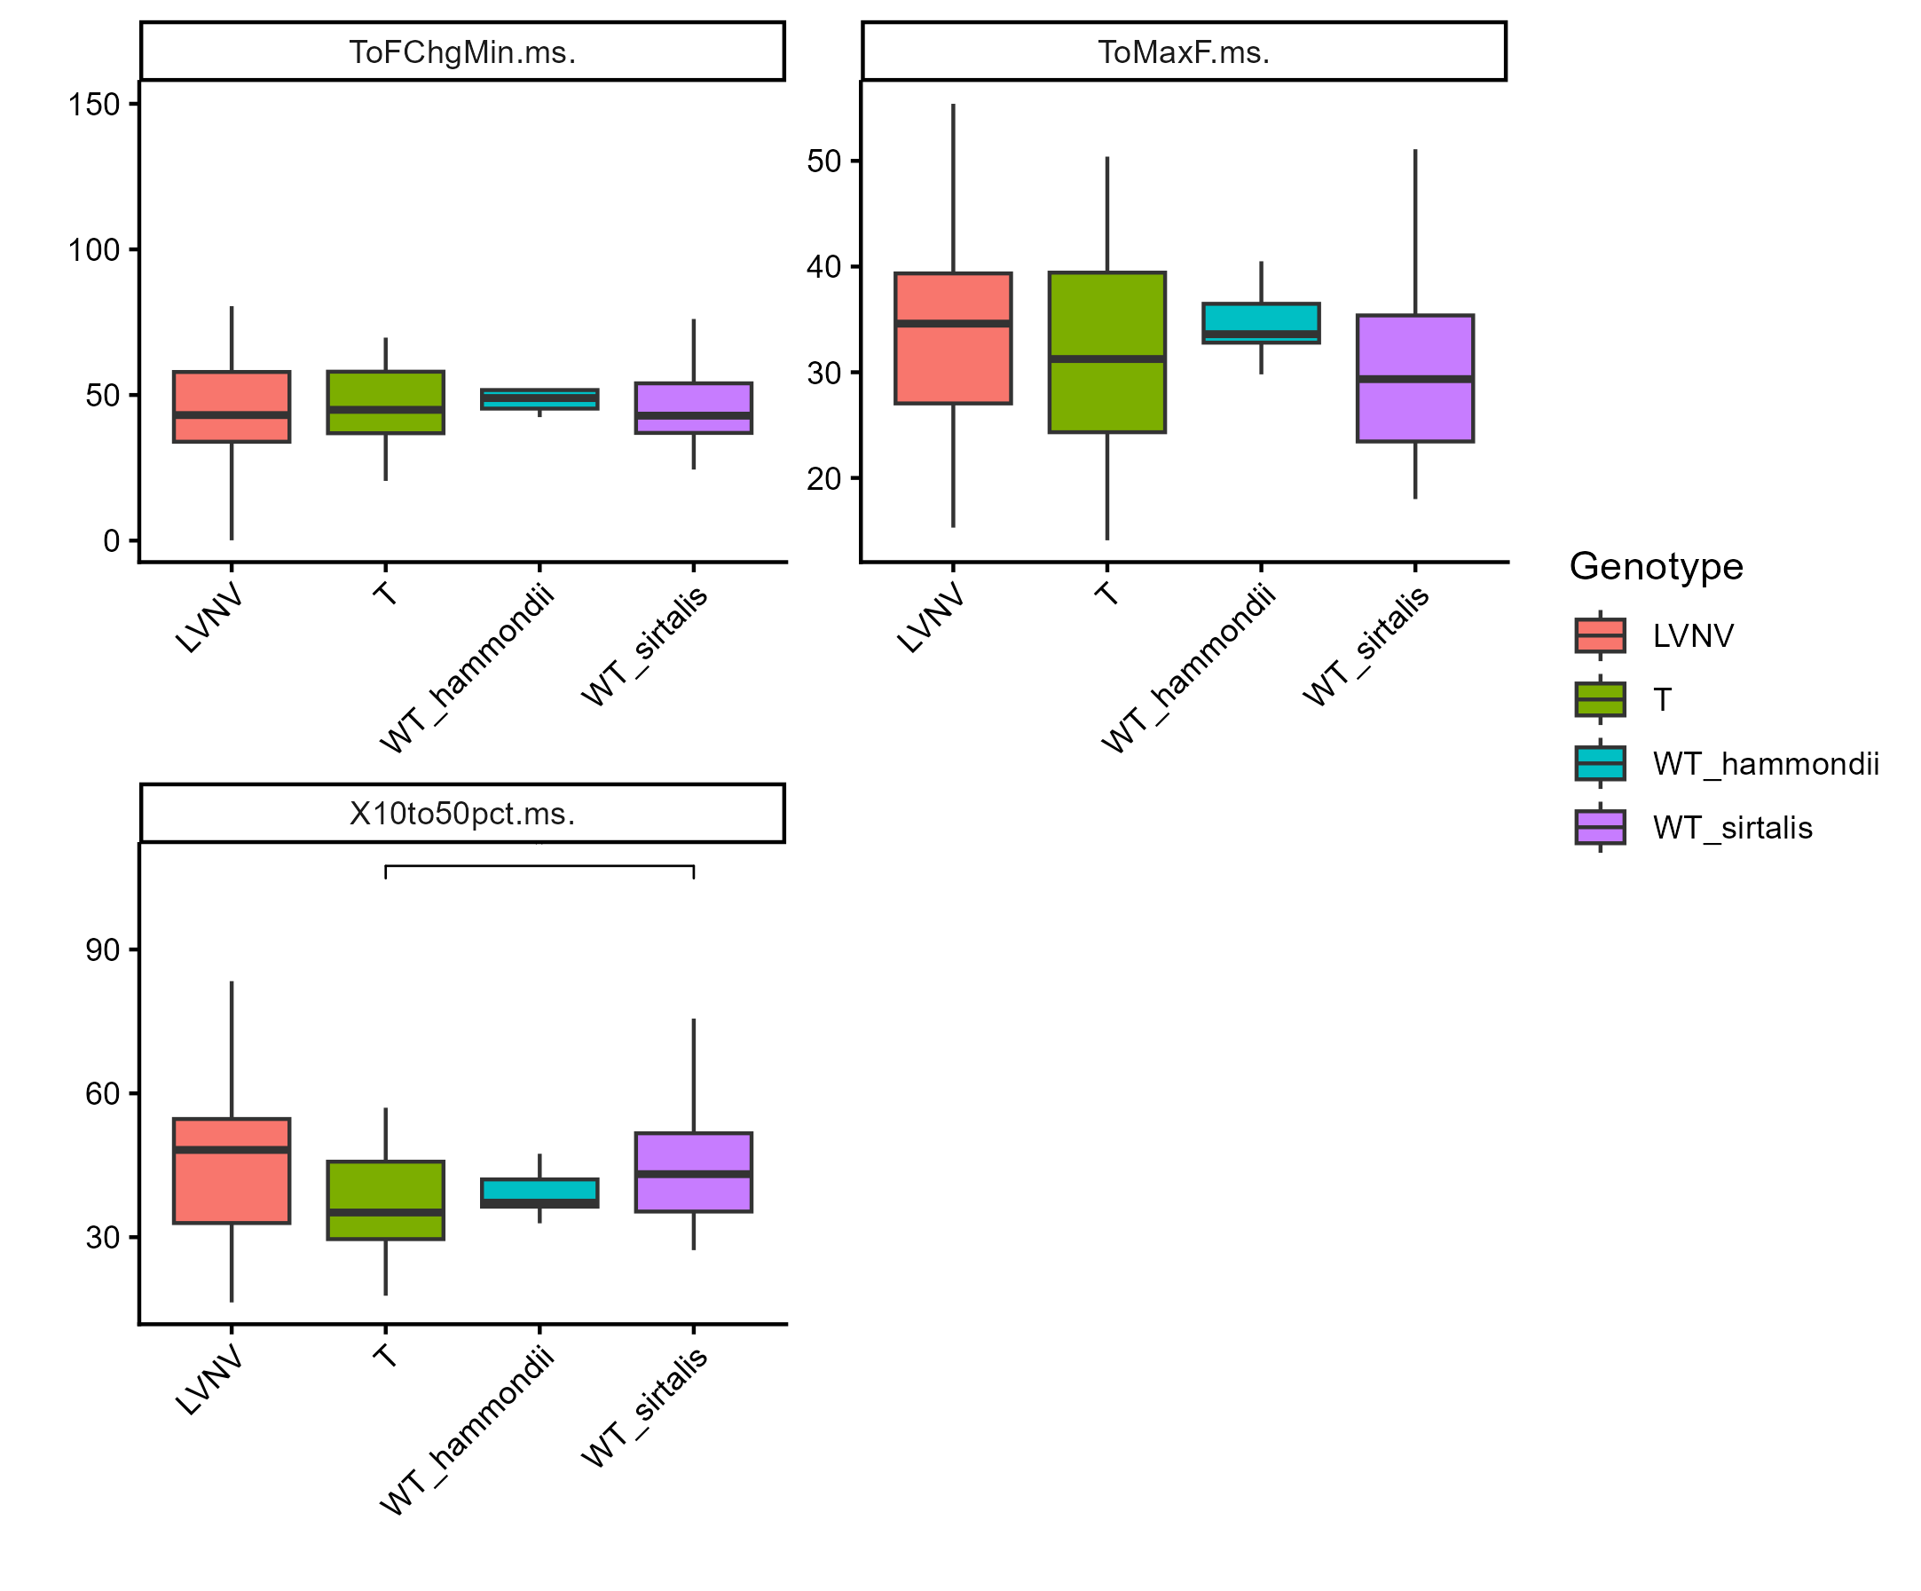
Notes:
Prev plots continued. In order, they are time to minimum rate of force change, time to maximum force/peak contraction, and time from 10% contraction to 50% relaxation. These are all the summary stats bobby included in his paper/work

Slide 12
Tetanic contractions (tetanus)
Same note about the colors, apologies that they’re all wonky again

Slide 13
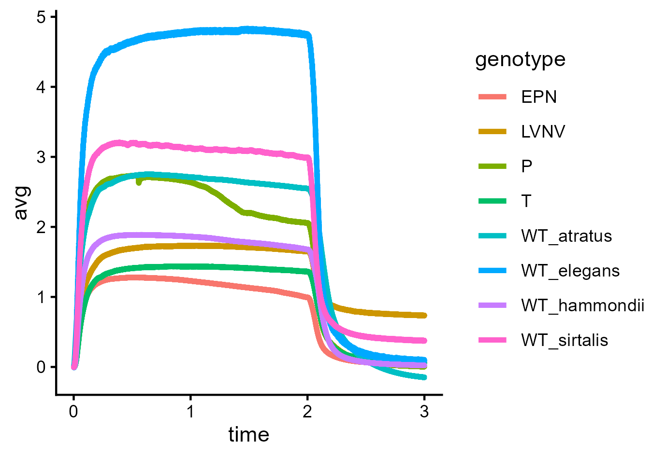
All

Slide 14
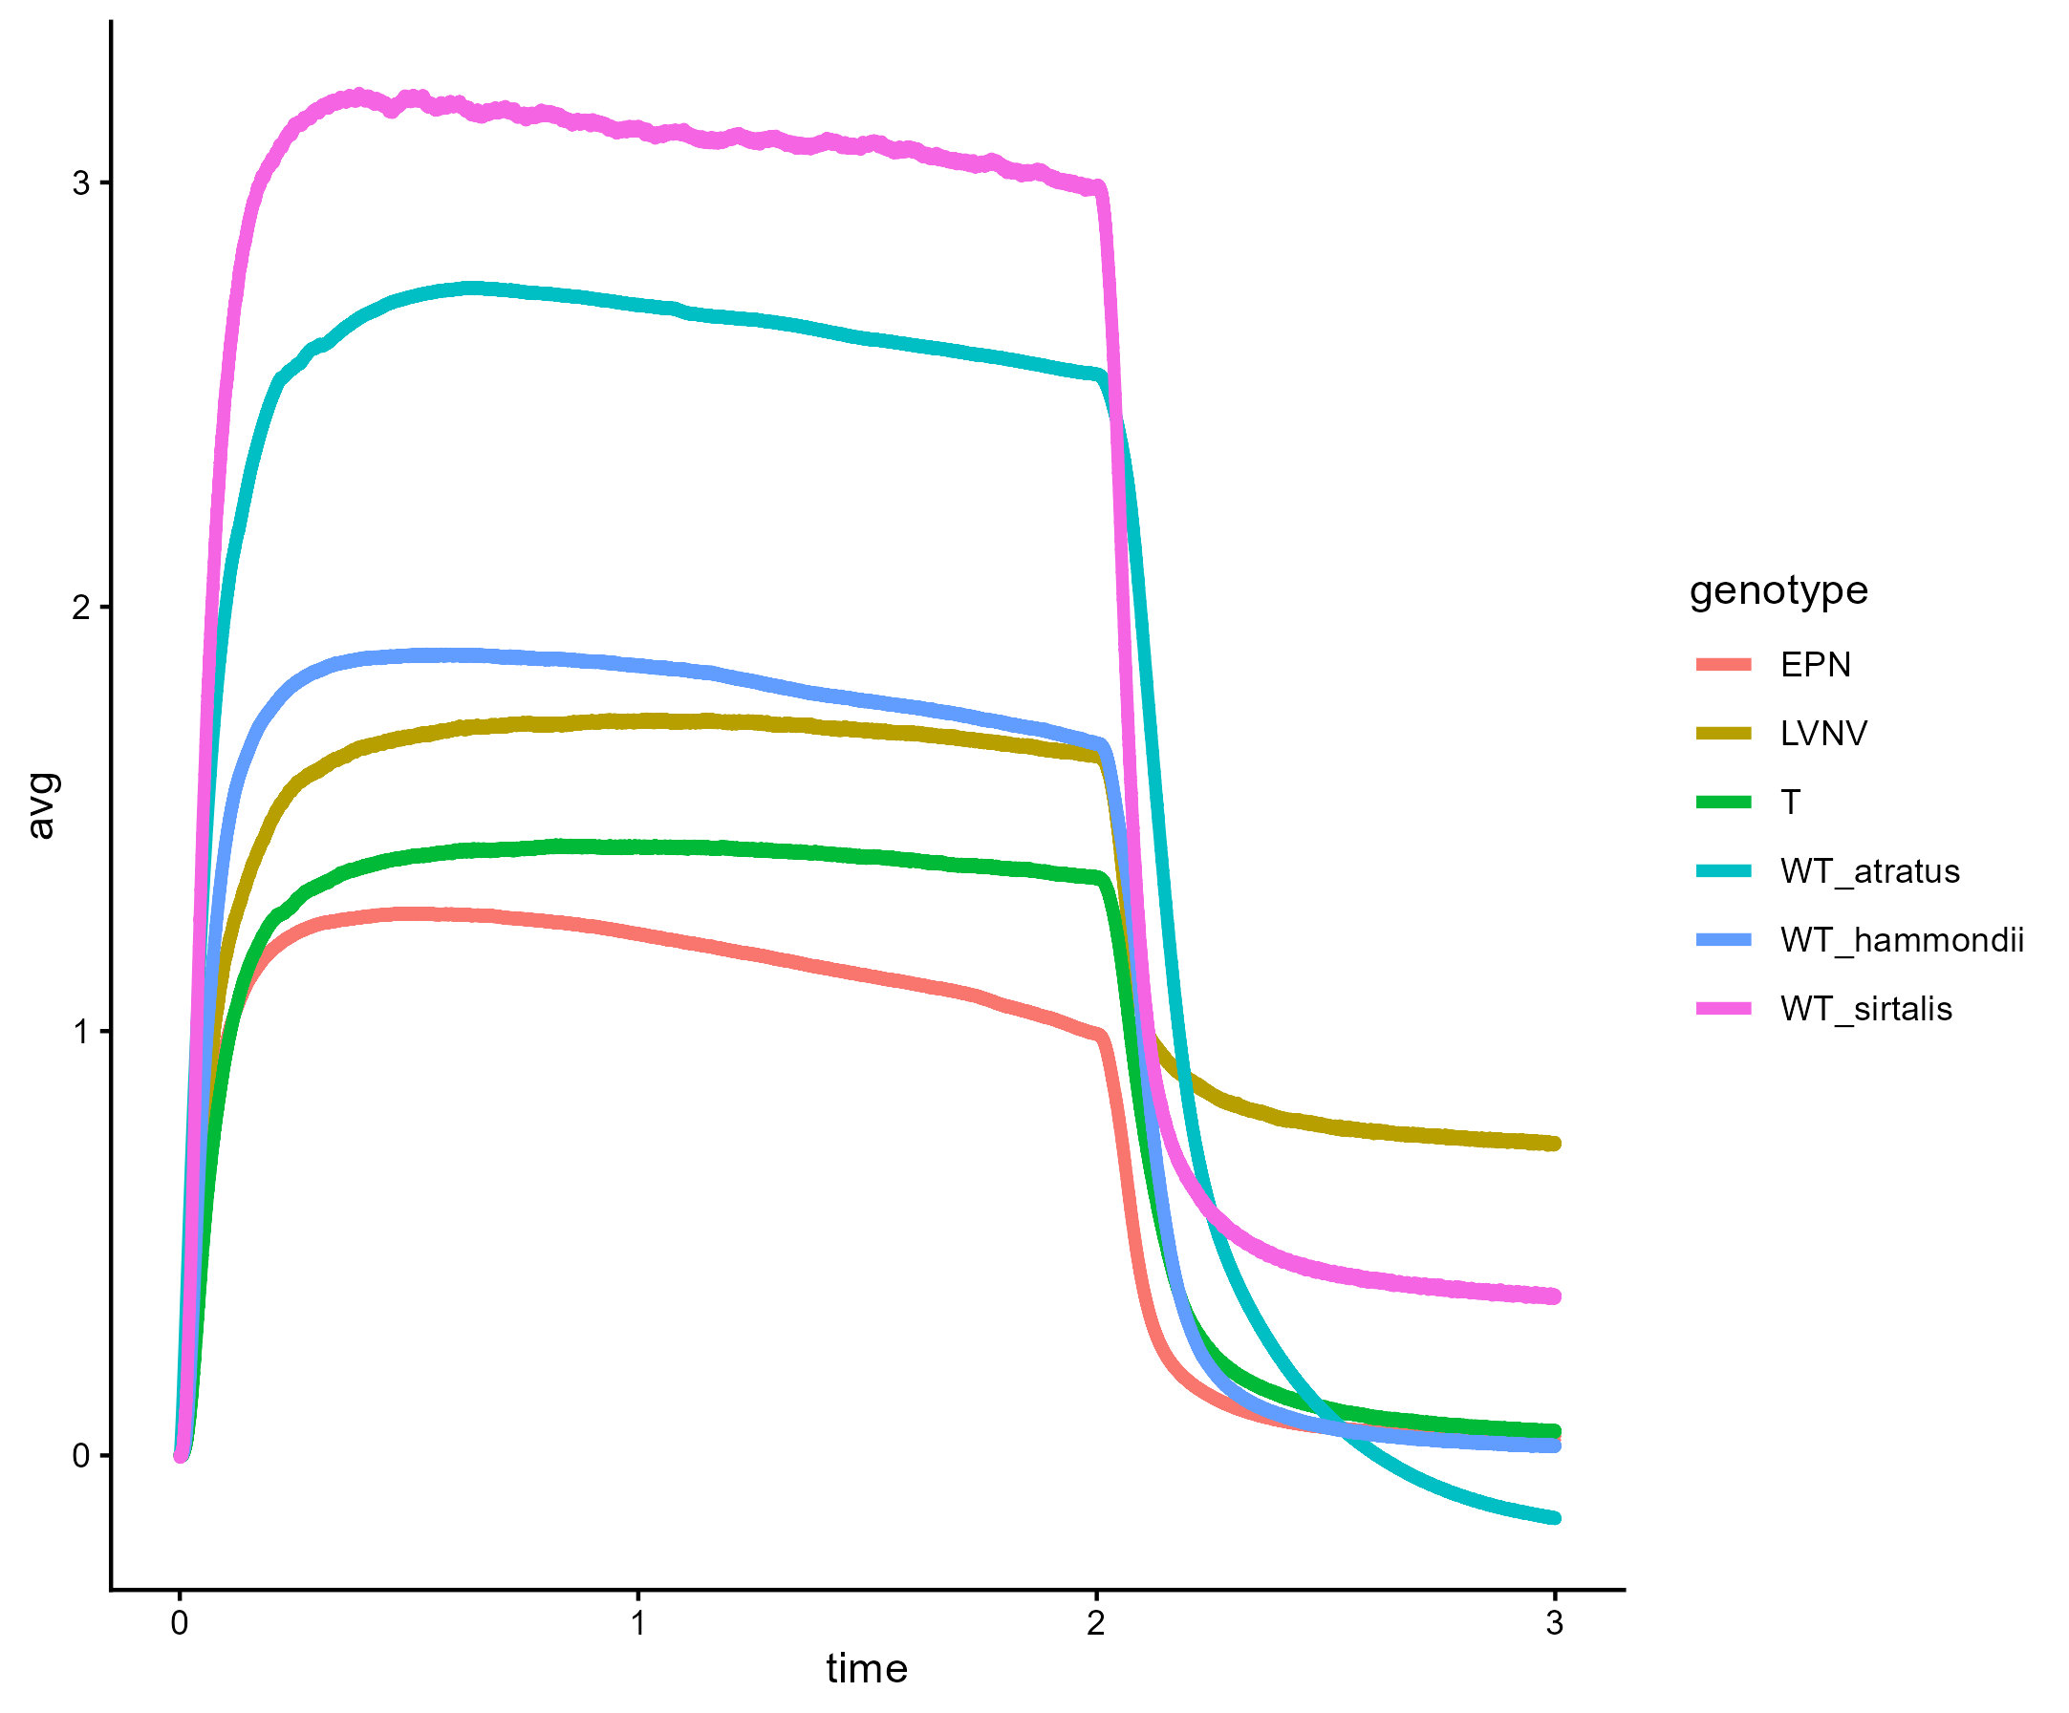
Prev minus WT elegans and P
Notes:
Trace of all tetanic contractions from the species/genotypes I think we’re liable to actually use, with the outliers generally filtered out so it looks better than previous iterations have. I do have error bars for these but the plot is illegible with them all on here, just know I can add them to future iterations (and if there are any you’re specifically curious about just email me if you can before the meeting and I’ll make them.

Slide 15
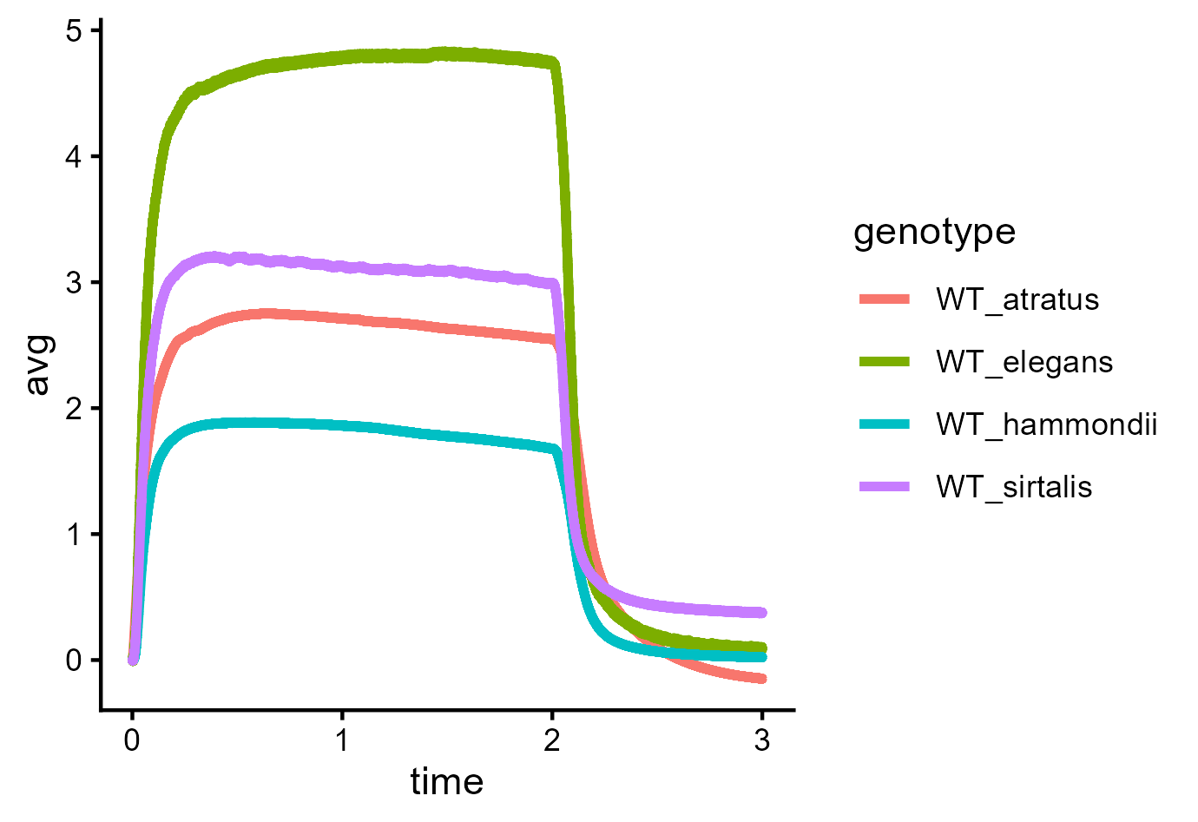
All WT

Slide 16
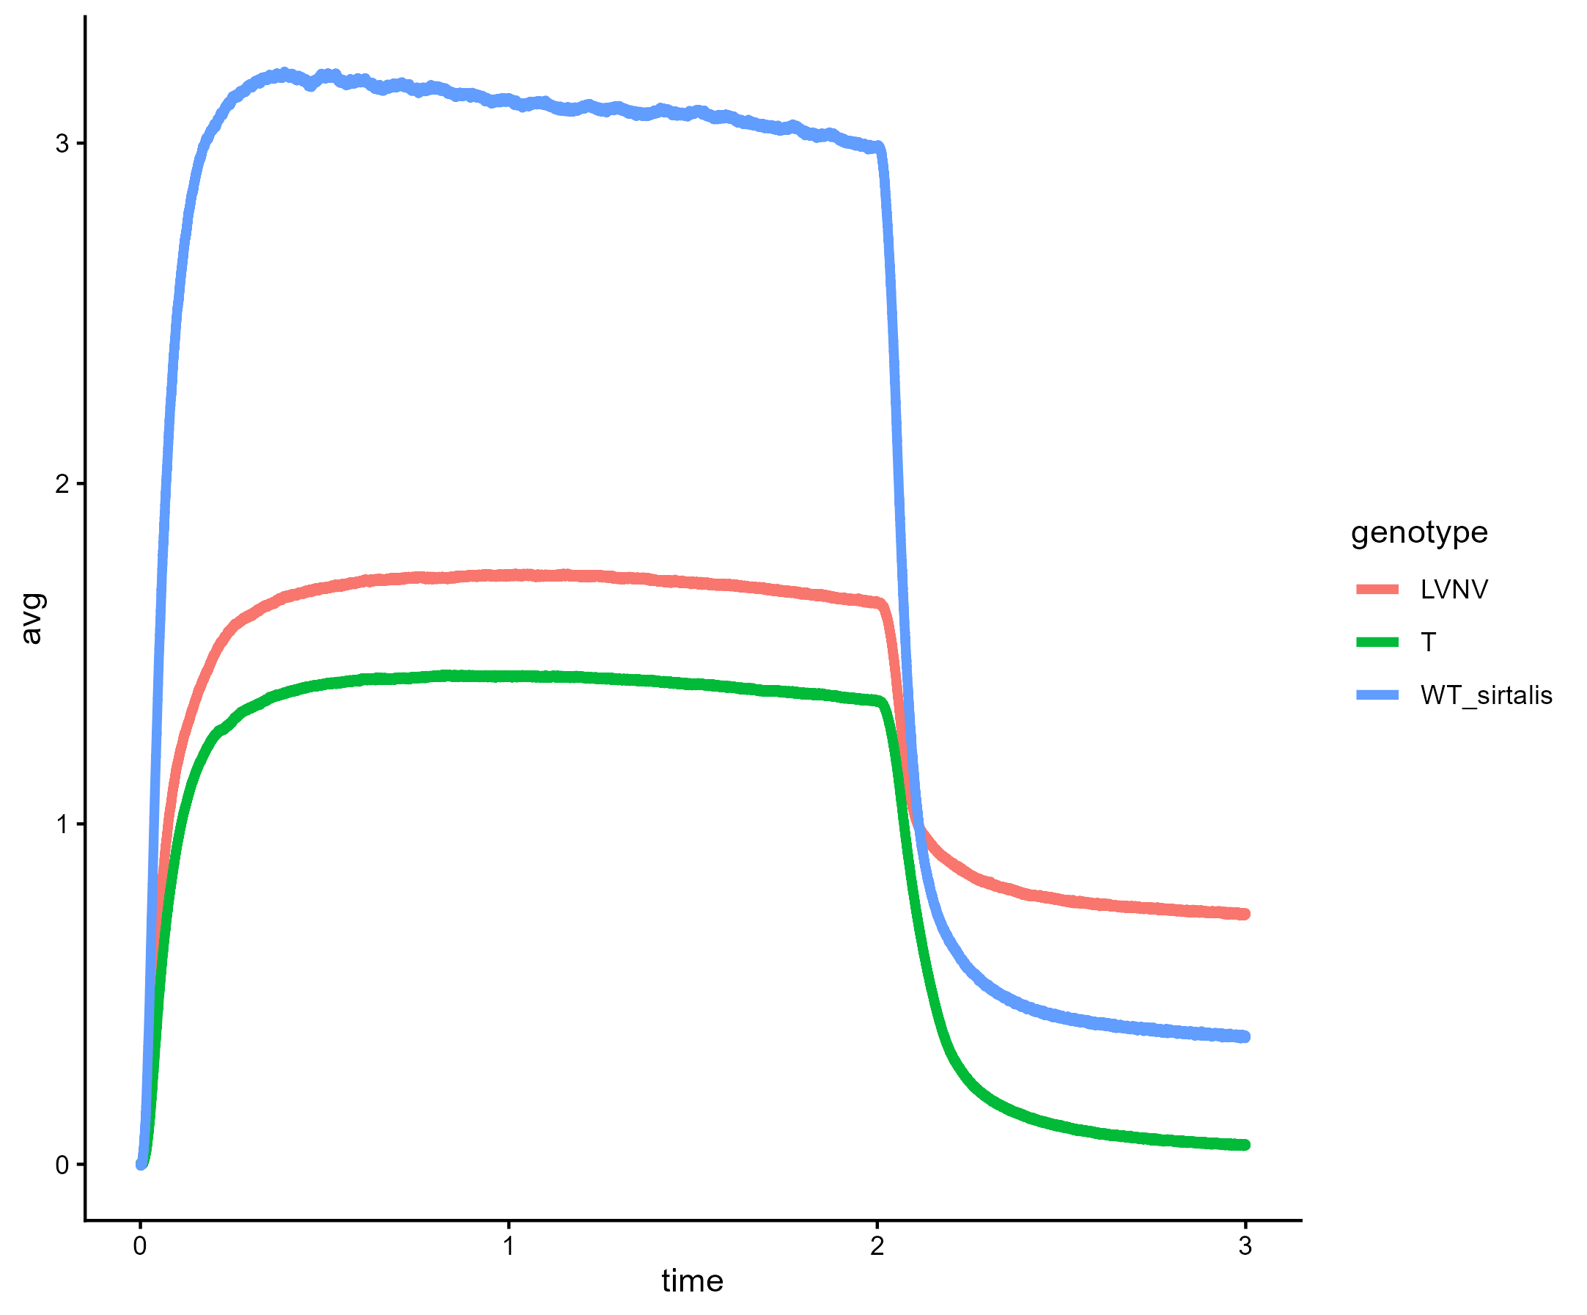
LVNV, T, and WT sirtalis
Notes:
Subset of prev plot with just LVNV, WT sirtalis, and T

Slide 17
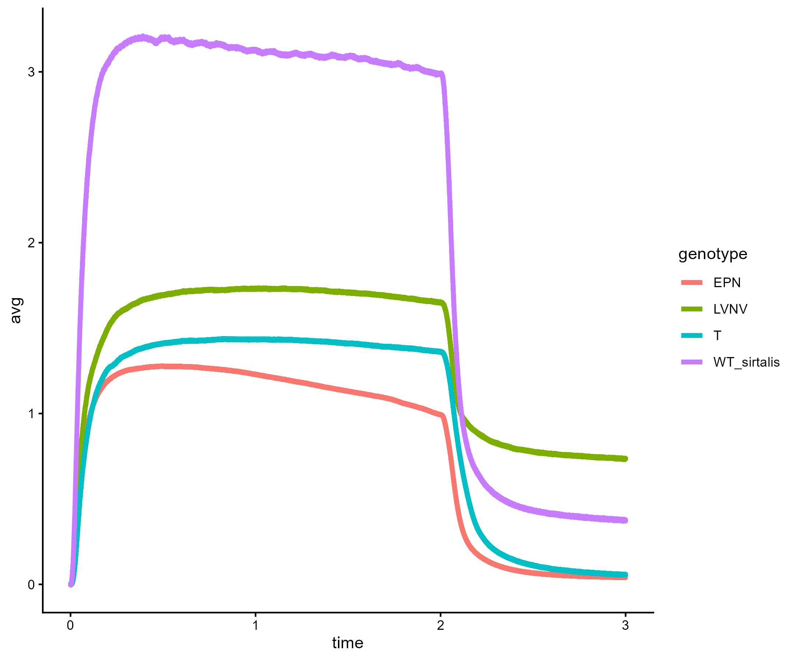
LVNV, EPN, T, and WT sirtalis
Notes:
Subset of first plot with EPN, LVNV, T, and WT sirtalis

Slide 18
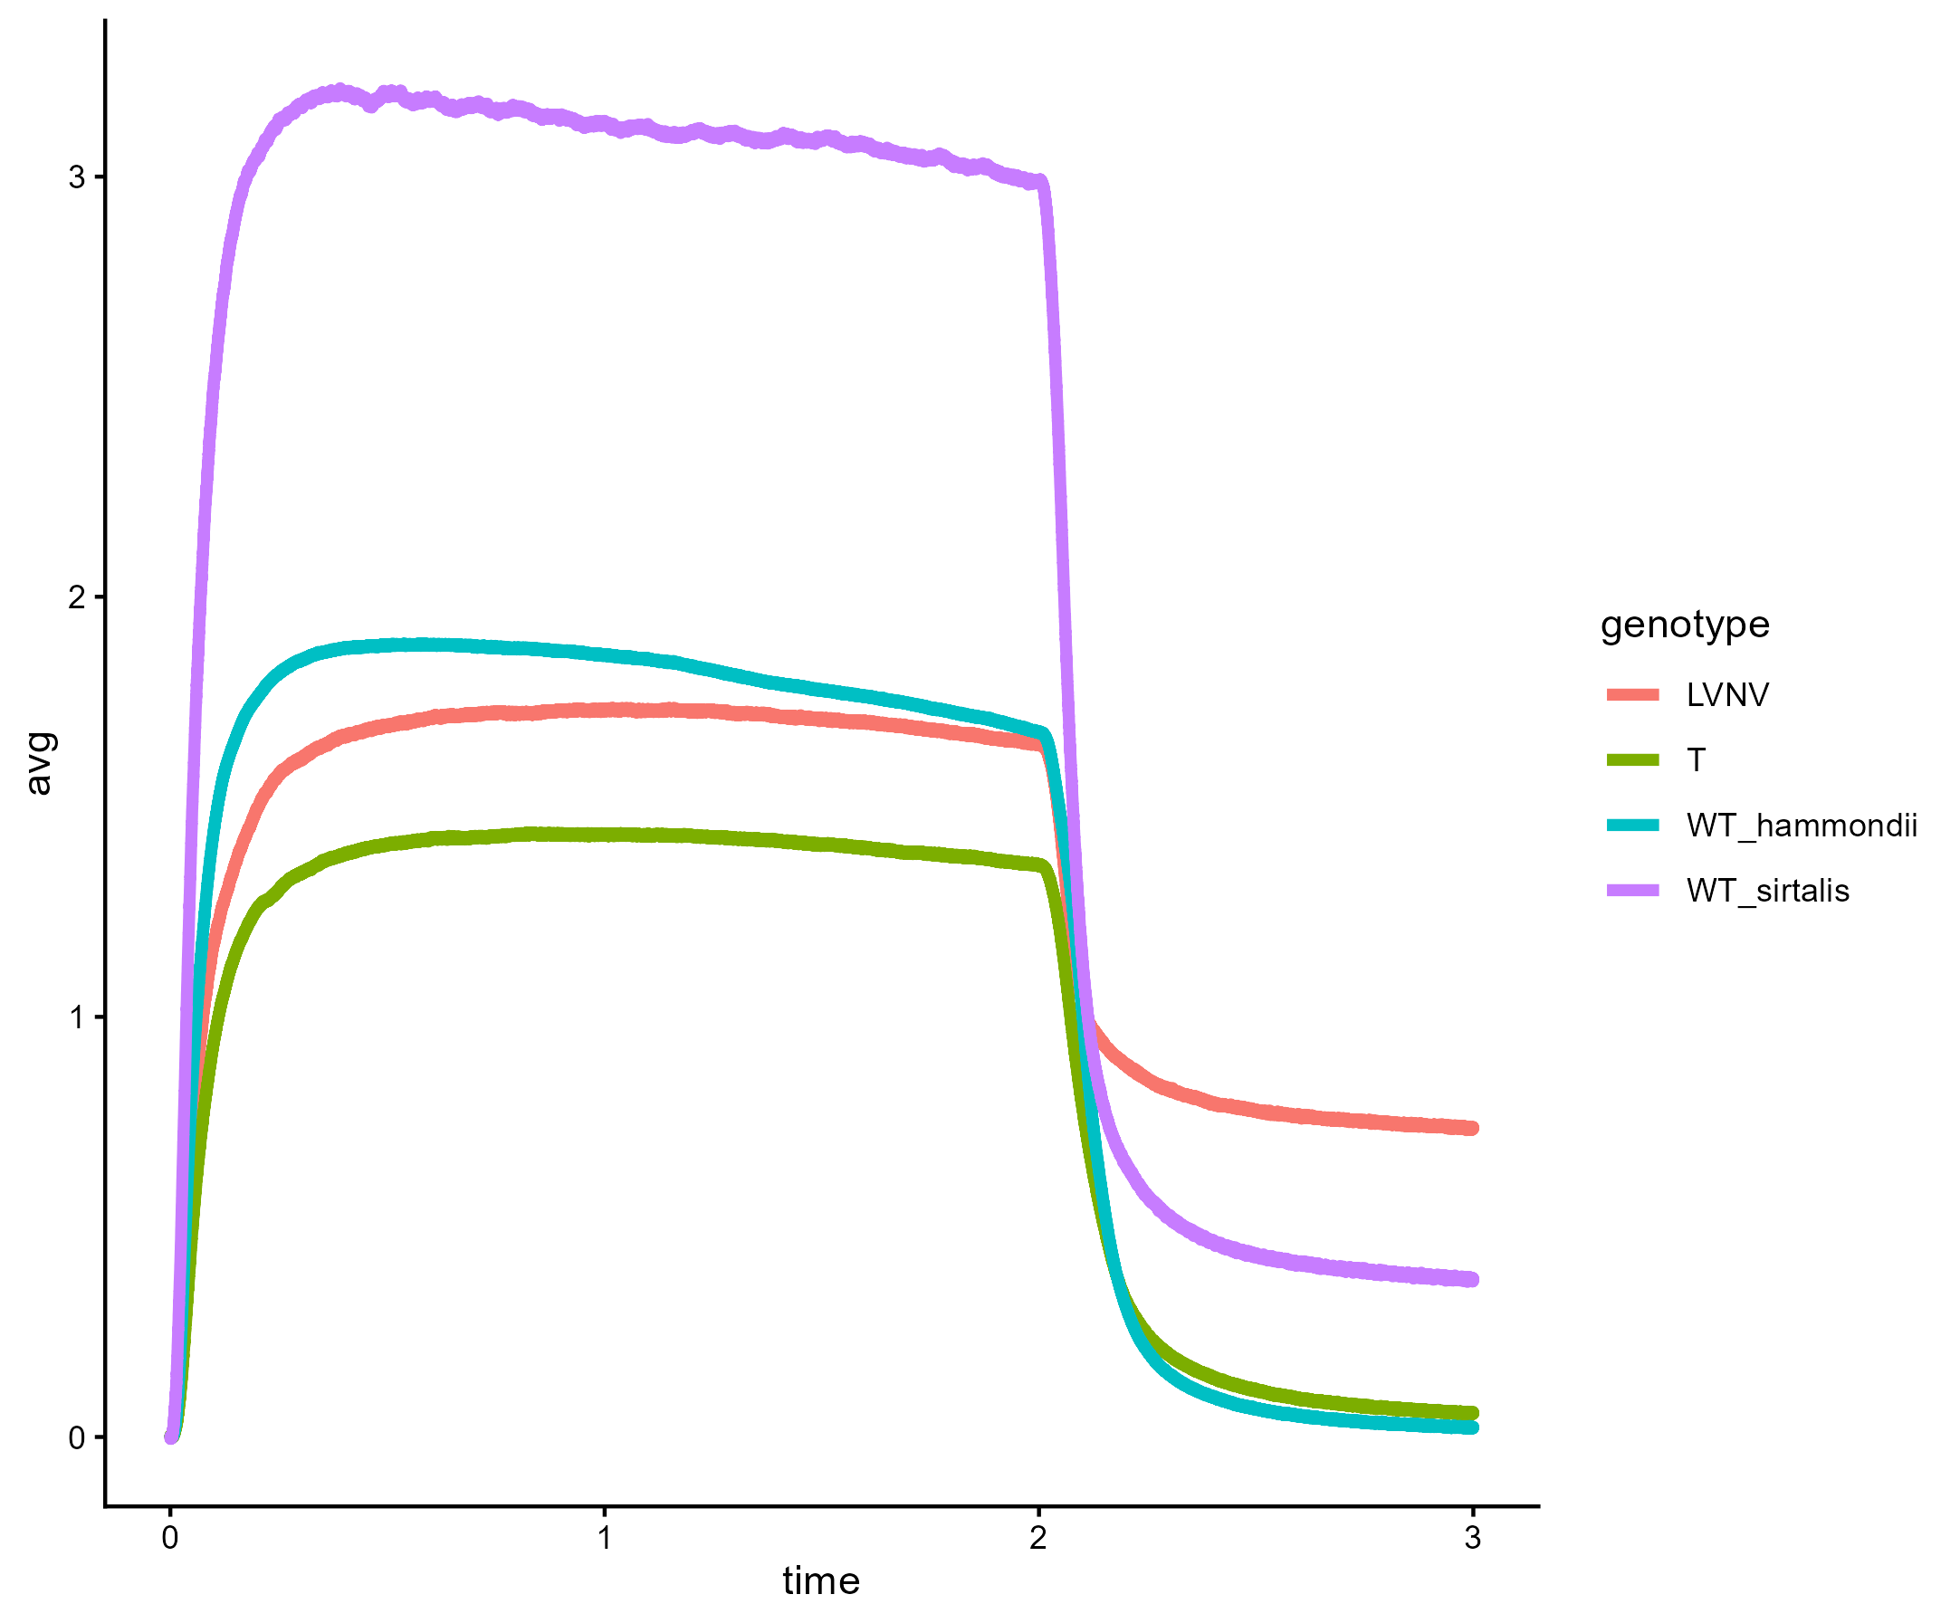
LVNV, WT sirtalis, T, and WT hammondii
Notes:
Alt version of the previous plot with LVNV, WT sirtalis, T, and WT hammondii

Slide 19
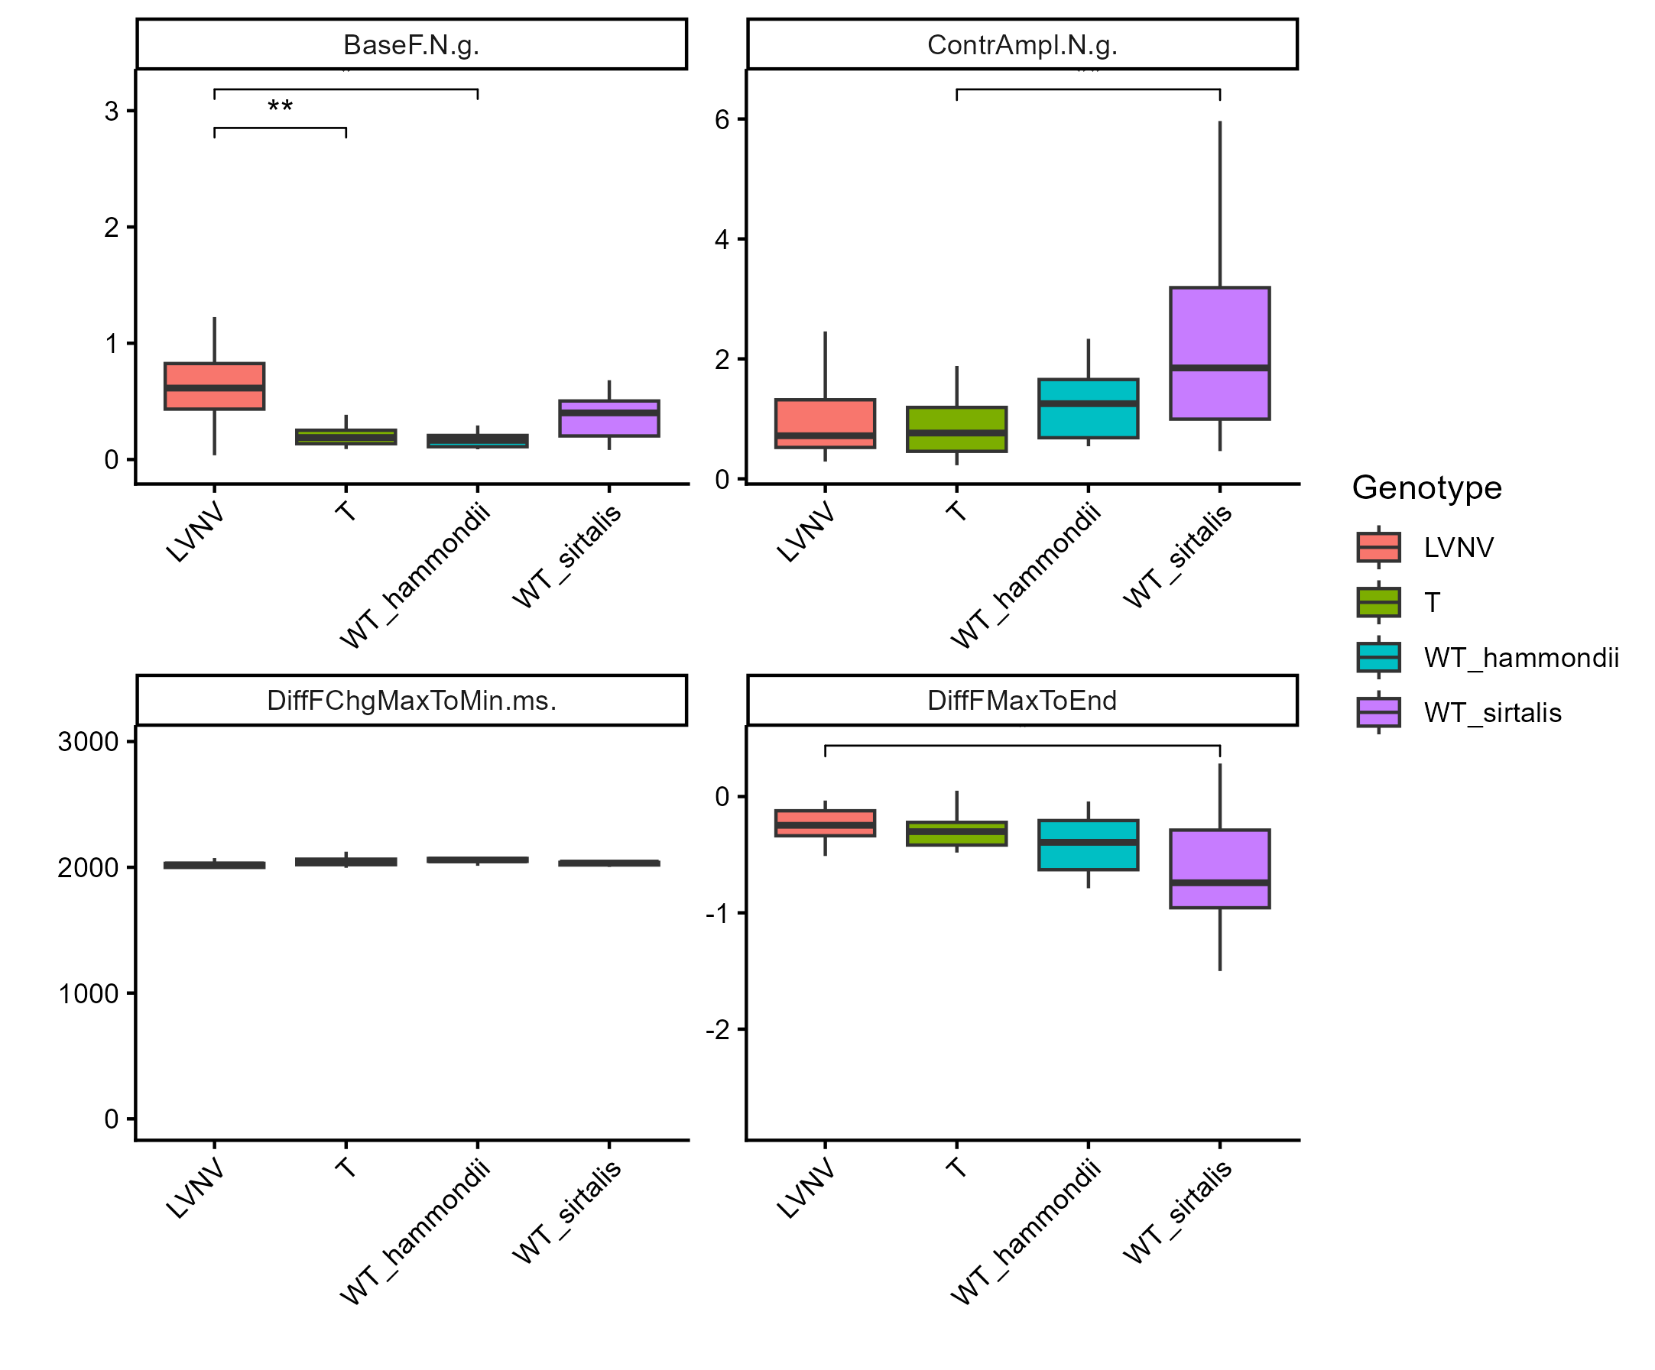
LVNV, WT sirtalis, T, and WT hammondii
Notes:
Boxplots comparing summary statistics for the tetanic contraction performance curves for these 4 genotypes/species. Bars with asterisks indicate significant differences, number of asterisks indicates higher significance. In order, plots are Base force, Contraction amplitude, time from fastest increase to fastest decrease in force (one measurement of contraction speed), and the difference in force during the maximum of the contraction vs at the end of the contraction (a measure of fatigue; bobby didn’t have this but I added it).

Slide 20
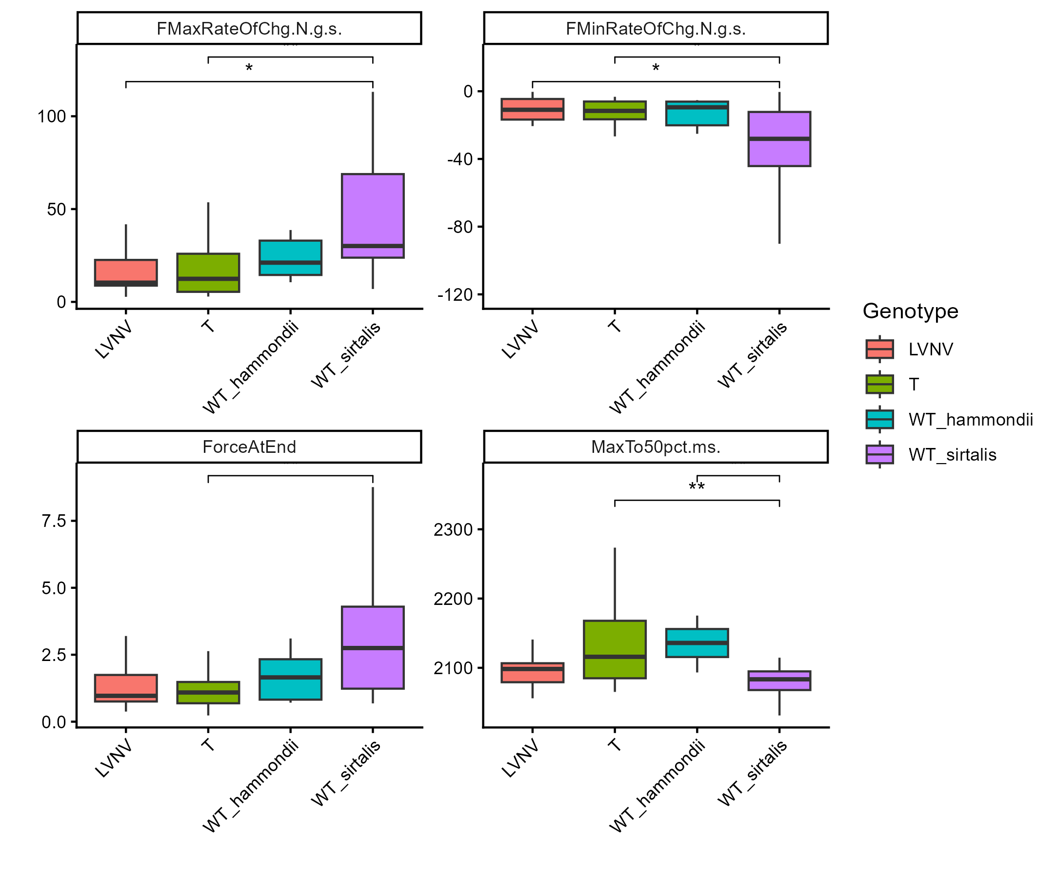
LVNV, WT sirtalis, T, and WT hammondii
Notes:
Prev plots continued. In order, they are rate of maximum force generation/contraction, rate of minimum force generation/relaxation, force at end of contraction (the other one I added that bobby didn’t have), and time from maximum contraction to 50% relaxation

Slide 21
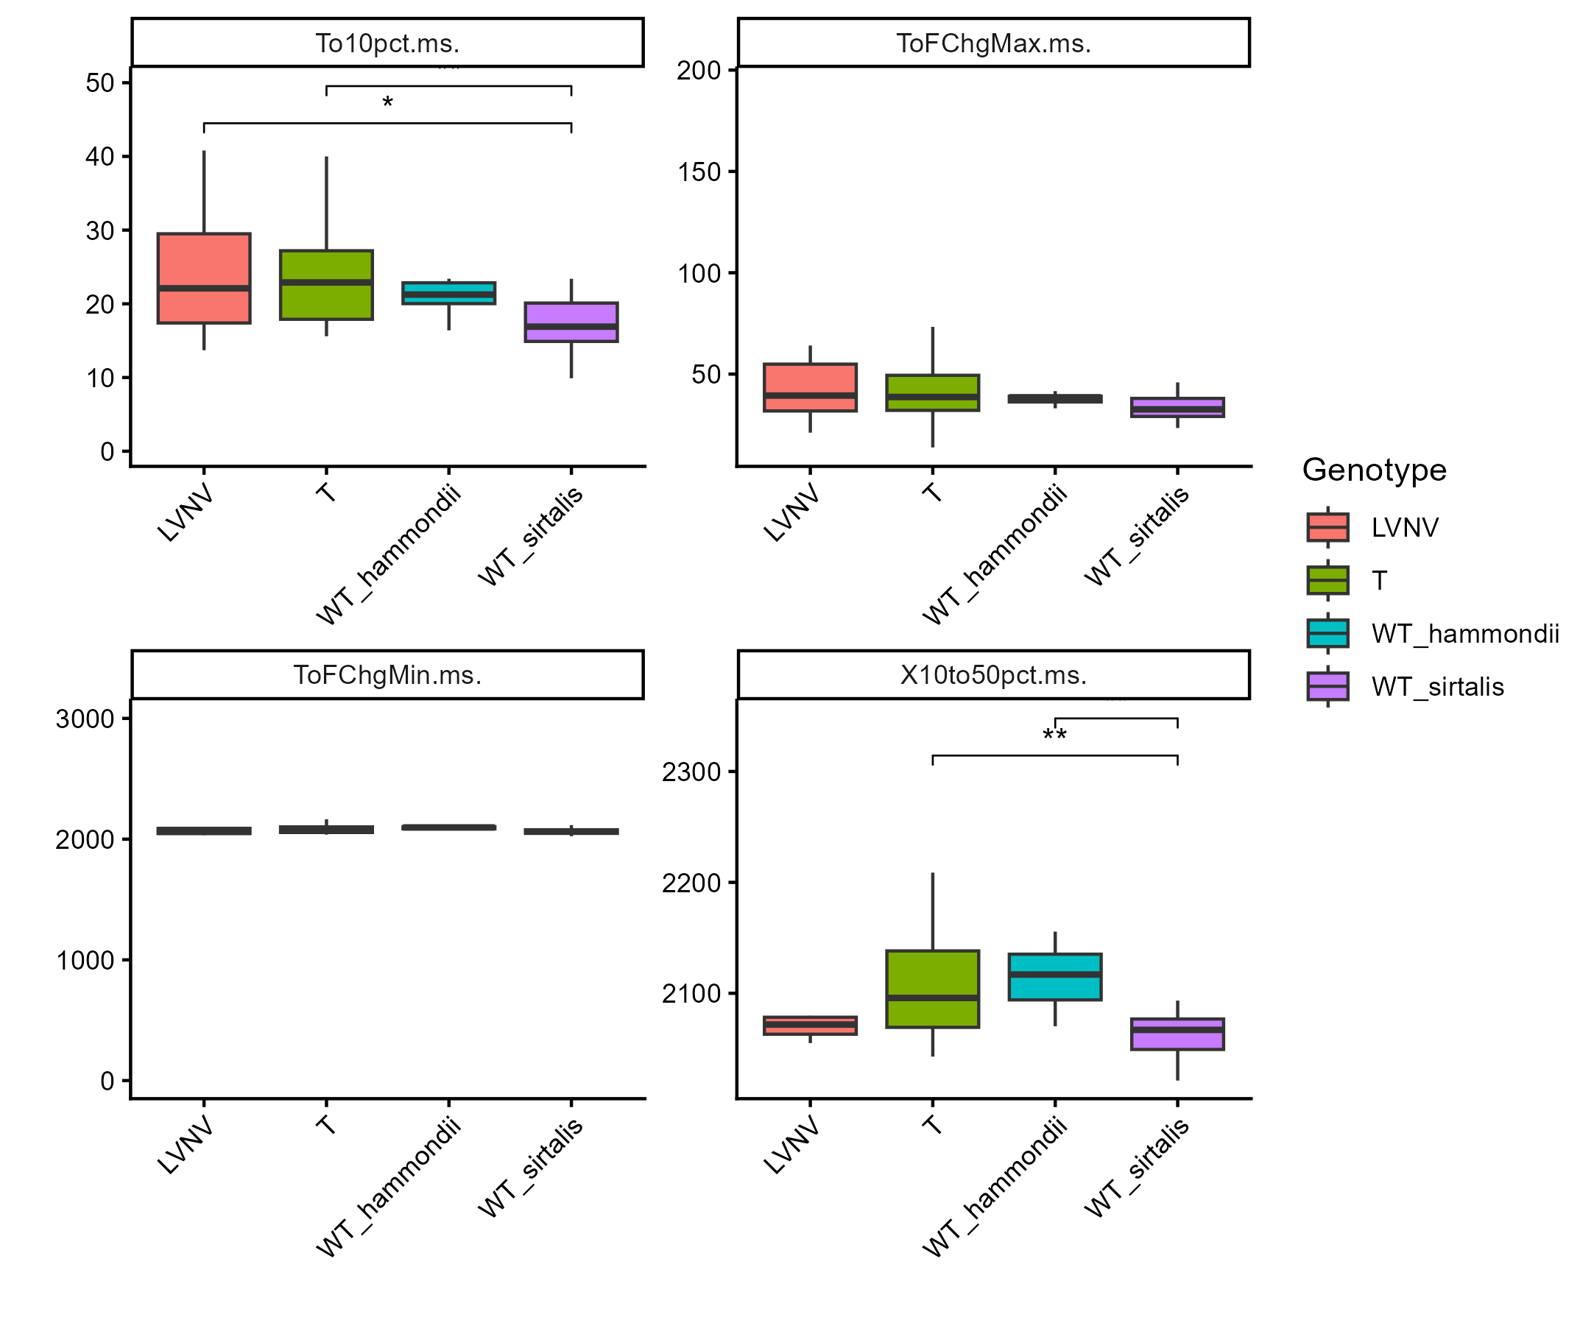
LVNV, WT sirtalis, T, and WT hammondii
Notes:
Prev plots continued. In order, they are time to 10$ force generation (onset), time to maximum rate of force change, time to minimum rate of force change, and time from 10% contraction to 50% relaxation. These are all the summary stats bobby included in his paper/work

Slide 22
Rheobase protocol
No WT atratus on these plots yet because their files are all in .dat and/or .ddf format and I can’t open them

Slide 23
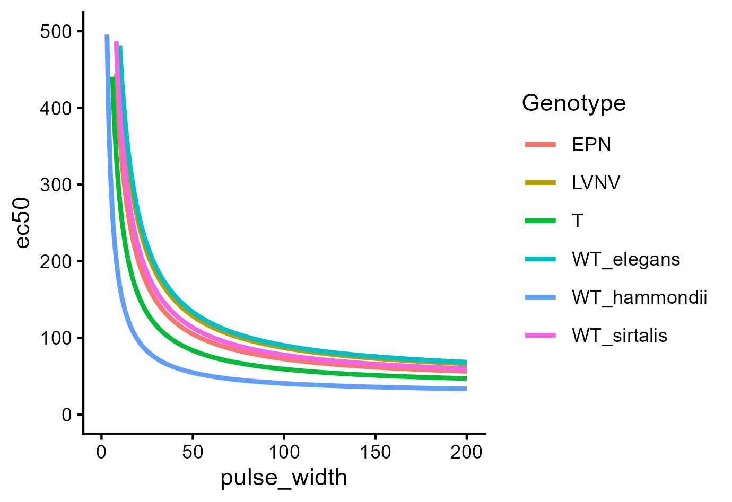
Average strength-duration curve
Notes:
Plot shows average stimulus strength required to get a half-maximal contraction at different pulse widths; it was truncated to show differences because values become comparable across groups at higher pulse widths. Despite apparent visual differences, none of these curves are statistically different (I need to double-check my curve fitting algorithms and try overlaying the raw data before being confident in that)

Slide 24
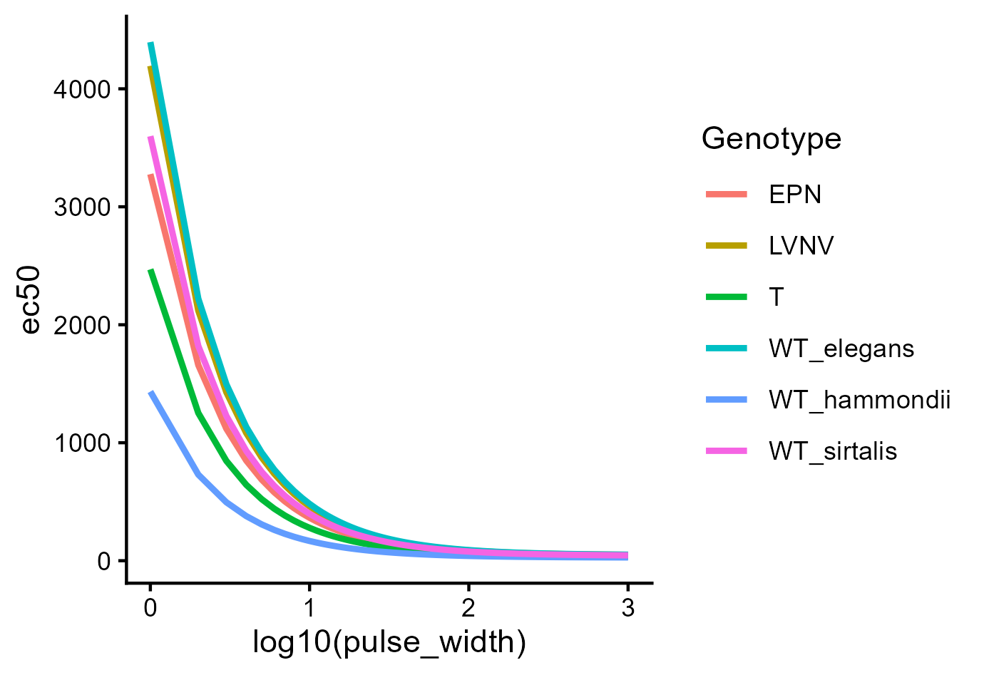
Log strength-duration curve
Notes:
Same as previous plot but the x axis is on a log 10 scale so we don’t have to truncate it; this is more true to how these curves are typically presented in the literature although I haven’t made the axes labels more easily interpretable yet. Underlying data is all the same though.

